Slide 1
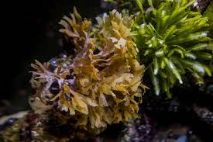
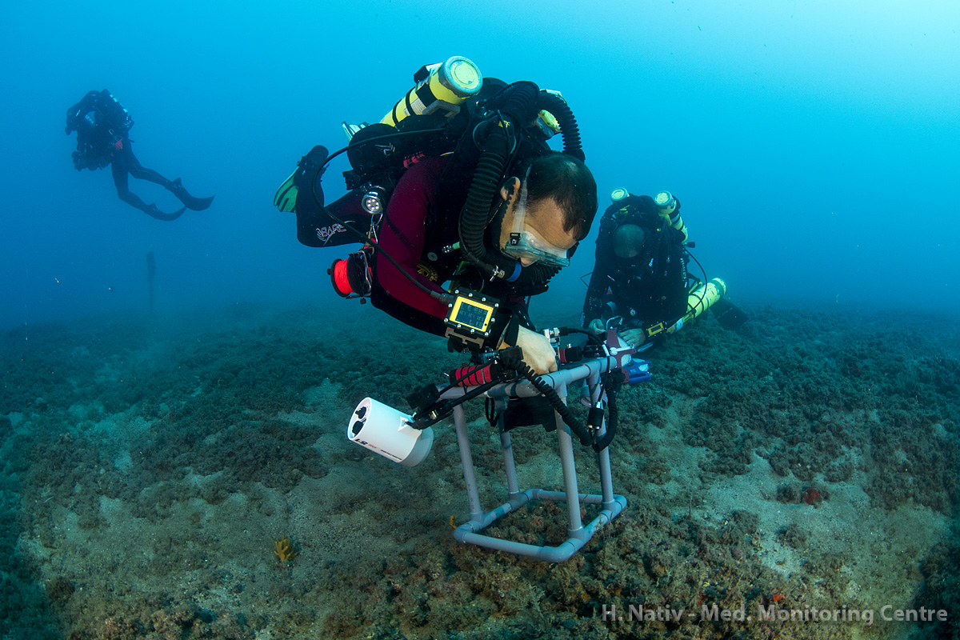
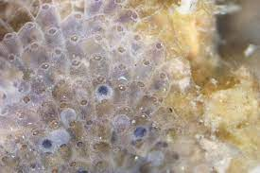
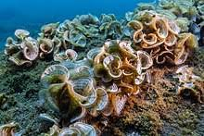
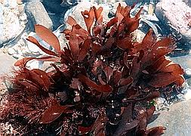
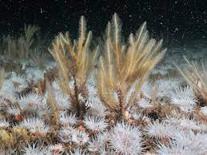
Med Sea Photo
Survey Analysis
Liad Elkobi, Ohad Gamliel, Noam Levi Avshalom

Slide 2
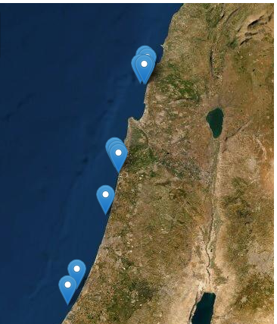
Our Data - Data collection
Marine Conservation
Achziv
Naharia
New in Israel
Many anthropogenic threats
Climate change
Good Data = better conservation
Dor
Sdot Yam
Ashdod
Data source:The Morris Kahn Marine Research Station
Ashkelon

Slide 3
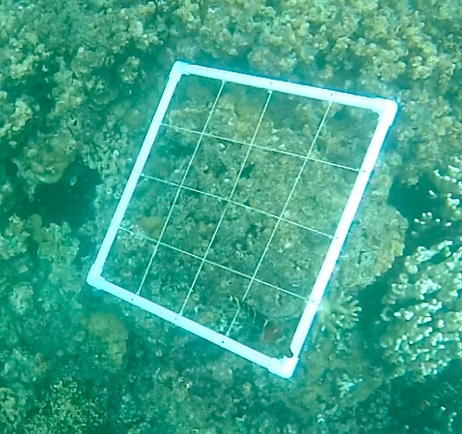
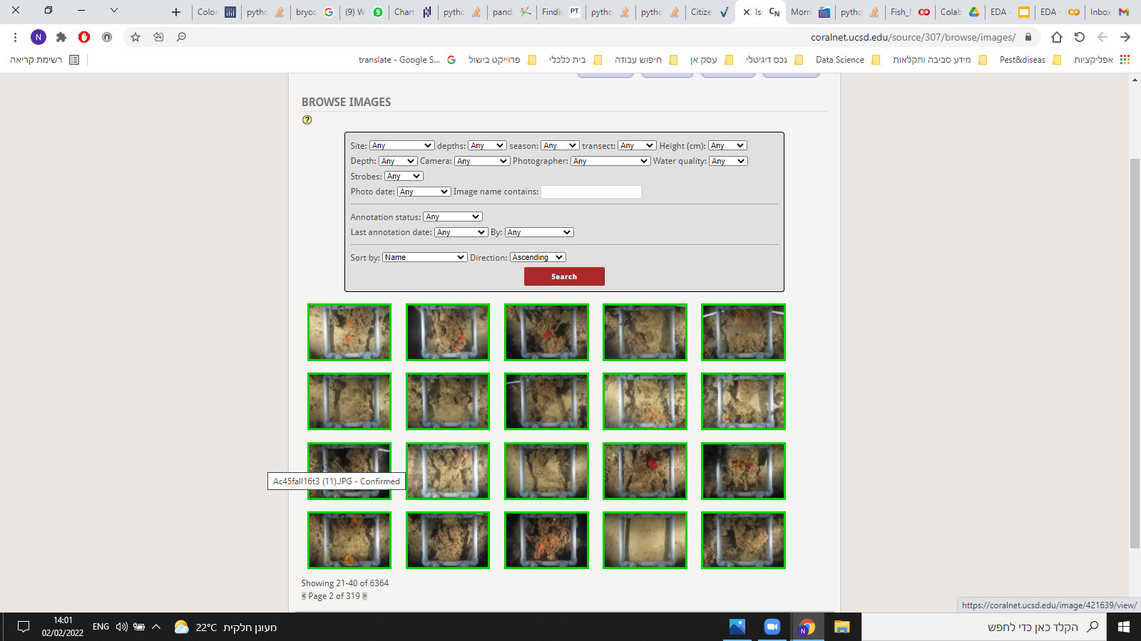
Photo Survey - Data collection
Object Recognition Algorithm & Sampling Method
Photo Survey
Photo-quadrats (25 cm2) every 2 meters along a 25 meter transect line.
4 transect lines at each site (& depth).
Upload photo to Coralnet website for Automated annotation.
Stratified Random Annotation Model
Using stratified random annotation point generator - 4 x 4 matrix - generate 16 rows for every photo.
Taxa group is automatically classified at 90% confidence level, if not classification entered manually.

Slide 4
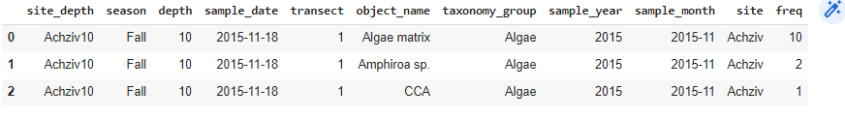
Photo Survey - Data exploration
Data Description
Sample Date - 90 sampling days
Season - Fall, Spring
Site -5 different sites
Depth -10,25,45
Transect - 1-4
Object Name \ Organism - 63 differnt organisms
Taxonomy Group - 11 tax groups

Slide 5
Photo Survey - Data exploration
Steps and Research Questions
Data exploration
Descriptive Statistics
Is there a correlation between the different organisms ?
How rich Is the organisms diversity along the different sites and years? is there a big difference ?
Which of the sites is the most stable?

Slide 6
Descriptive
Statistics

Slide 7
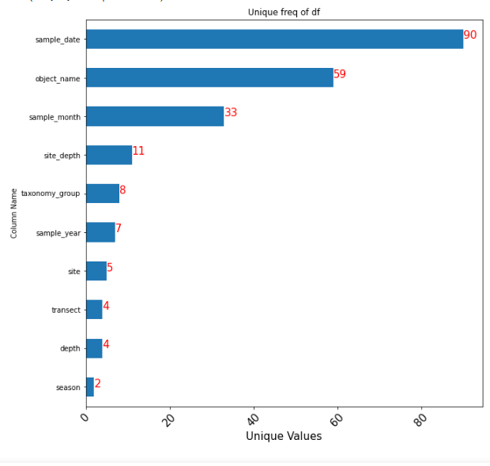
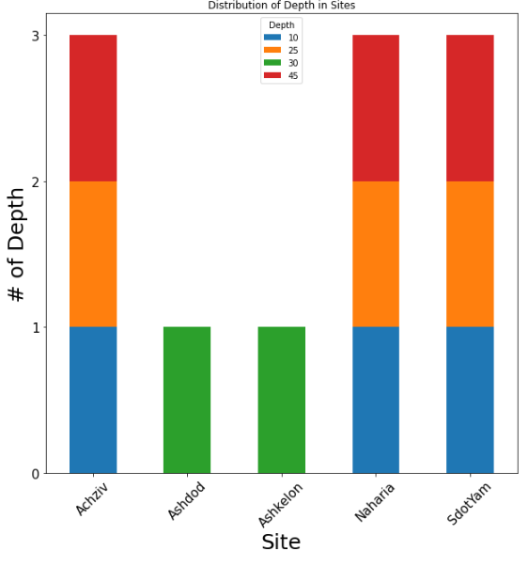
Unique Values Distribution
Unique Values in DF
Distribution of Depth in sites

Slide 8
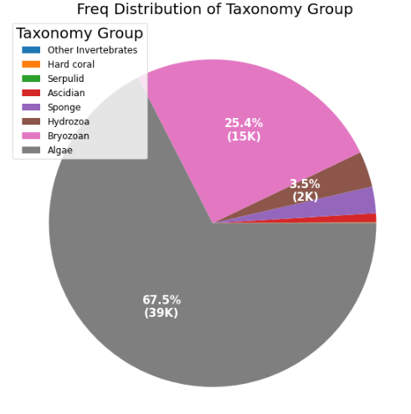
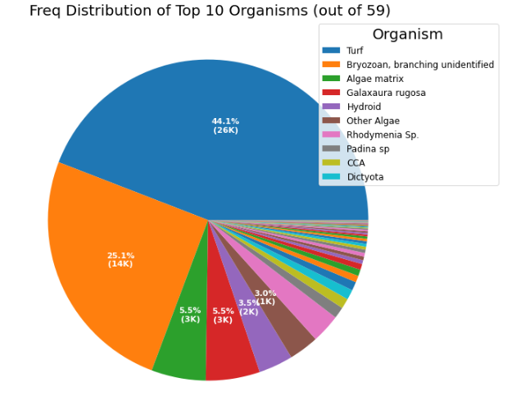
Distributions of Organisms

Slide 9

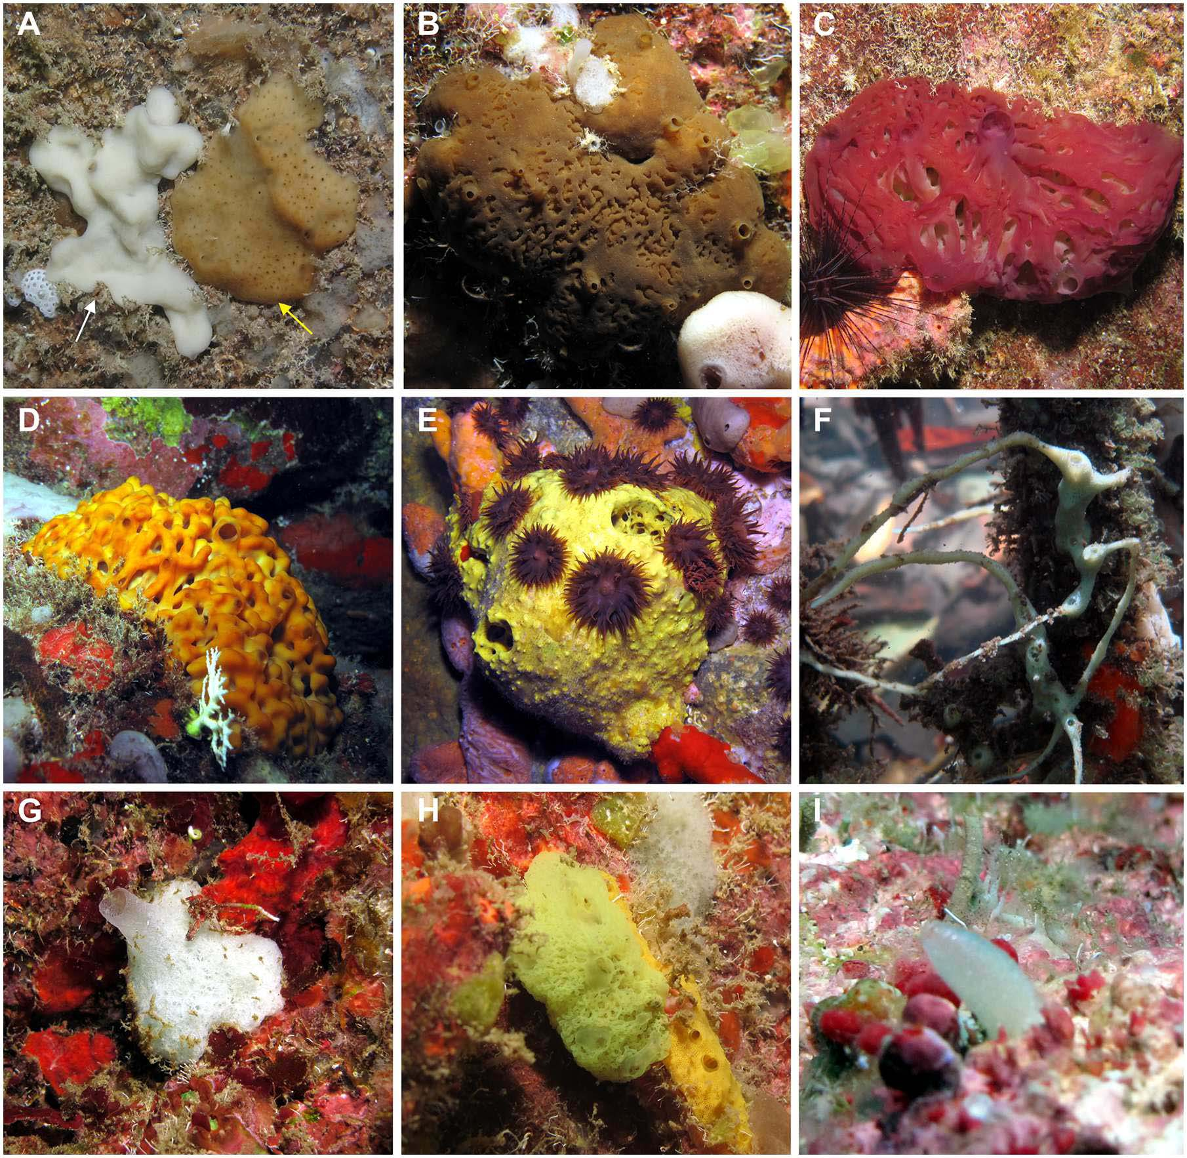
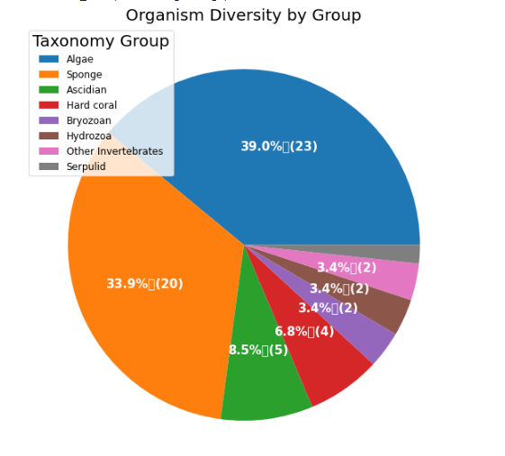
Organism Diversity By Group
Example of Sponge species
‘Sponge’ - High diversity low frequency( <3%).
Notes:
Although ‘Sponge ‘ tax. group has observed 20 different species , his total freq is less than 3%

Slide 10
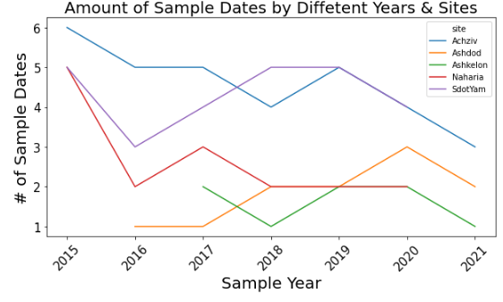
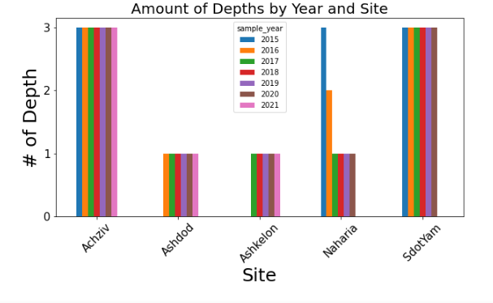
Potential Bias in the Data
Ashkelon and Ashdod - less sample dates ; one depth only .
Inconsistent number of sample dates along the years.
Different sample dates between sites & depths .
Non organism groups (shadow , sand etc. ).
Notes:
Ashkelon and Ashdod have much less sample dates as also began to collect data in 2017,2016
Naharia - number of different depth change over the years

Slide 11
Correlations &
Drill downs

Slide 12
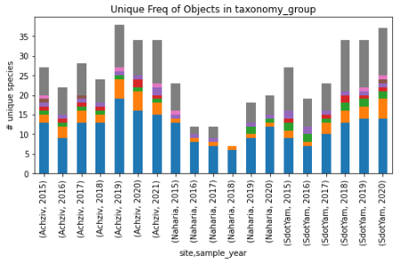
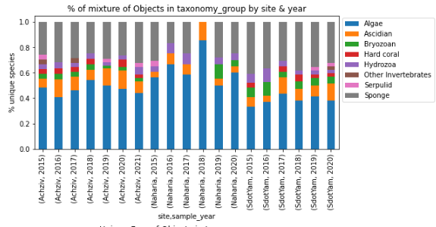
How rich Is the organisms diversity along the different sites and years?
Diversity Analysis (1)
Is there any differences in the biological diversity between different sites and years ?
Separate between Ashkelon & Ashdod to the rest of the df.
Sharp Drop in Naharia ,2015-2018 ; 2018 ‘Sponge’ & Hydrozoa disappeared .
Absence of hard coral in Naharia , higher % of sponge species in Sdot Yam .
Notes:
הסבר על טרנספומצייה של ההדאתא >> הסבר על הגרף >> תובנות
Sharp drop in organism diversity on Naharia due to reduce number of sample dates ? although 2020 has less sample dates but about the same diversity as 2015.
‘Sponge’ - High diversity low frequency

Slide 13
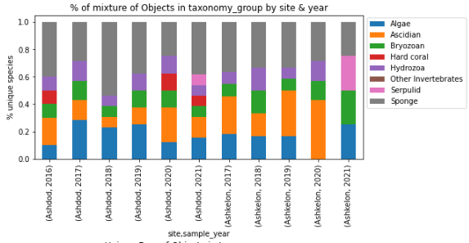
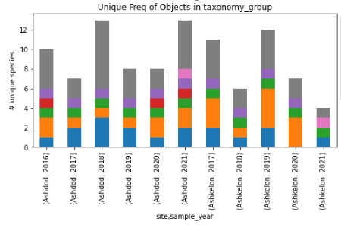
How rich Is the organisms diversity along the different sites and years?
Diversity Analysis (2)
Changes along the years - Ashkelon 2020 , Ashdod 2018
Low % of Algae species compared to other sites.
‘Turf’ (44% of data) is missing in Ashkelon & Ashdod .
No corals in Ashkelon
Notes:
We convinced that the lower diversity that we see in Ashkelon & Ashdod is due to bias in the data samling - less sample dates and less places(depths).
#there is also disapering of 'Algae' (taxonomy_group) in Ashkelon in 2020 . #Ashdod 2018 - much more % of sponge
Although ‘Turf’ is having 44% of the data , it has not been recognized in Ashkelon and Ashdod.

Slide 14
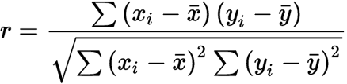
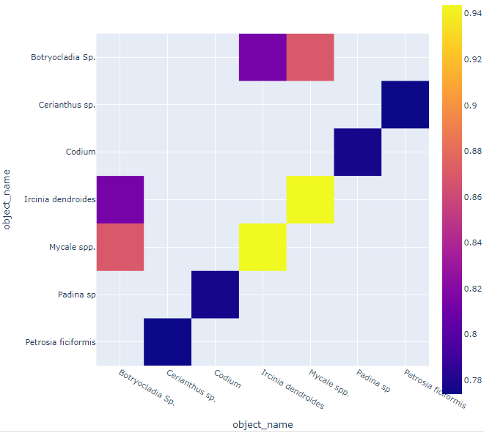
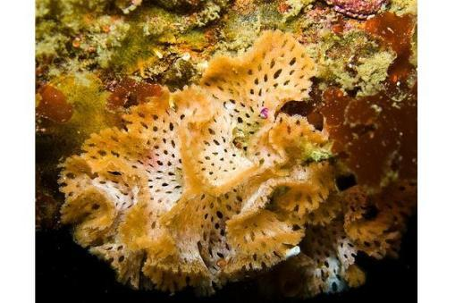
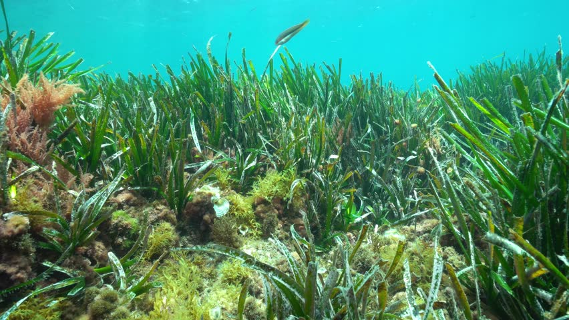
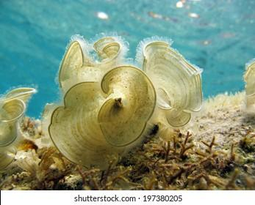
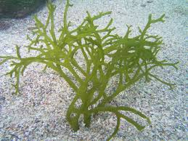
Is there a correlation between the different organisms ?
Linear Correlations between organisms
Using pearson correlation function we found:
Mid-strong correlation in opposite ratio between ‘Turf’ and ‘Bryozoan’.
Strong Positive correlation (>0.7) between 3 pairs of Organisms.
('Codium', 'Padina sp', 0.78)
('Botryocladia Sp.', 'Ircinia dendroides', 0.80 )
('Petrosia ficiformis', 'Cerianthus sp.', 0.77)
Pearson corr matrix - corr > 0.7 ( or < - 0.7)
Notes:
עונה על השאלה העסקית - האם יש קשר בין האורגניזמים השונים ?

Slide 15
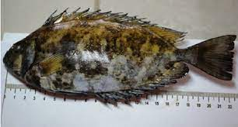
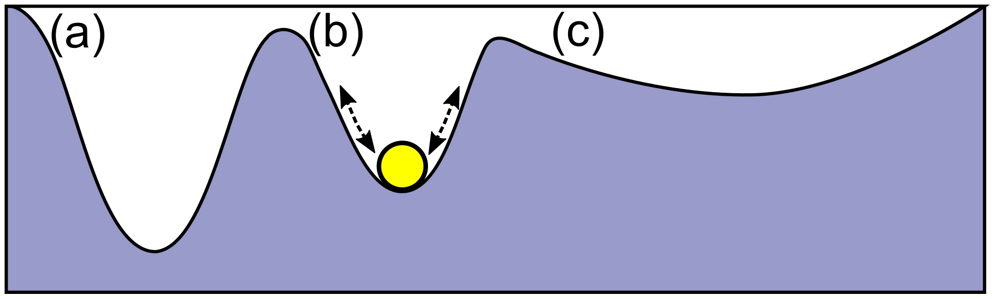
which of the sites is the most stable?
Which of the sites is the most stable?
Achziv 10
Achziv 25
Achziv45
Sdaot Yam 10
Sdaot Yam 25
Sdaot Yam 45
Naharia 45
Fish survey:
Eological stability:
Manually identified
The same exact location
Similar data structure
Regulation mechanisms:
Stability
resilience
Siganus rivulatus-סיכן משויש

Slide 16
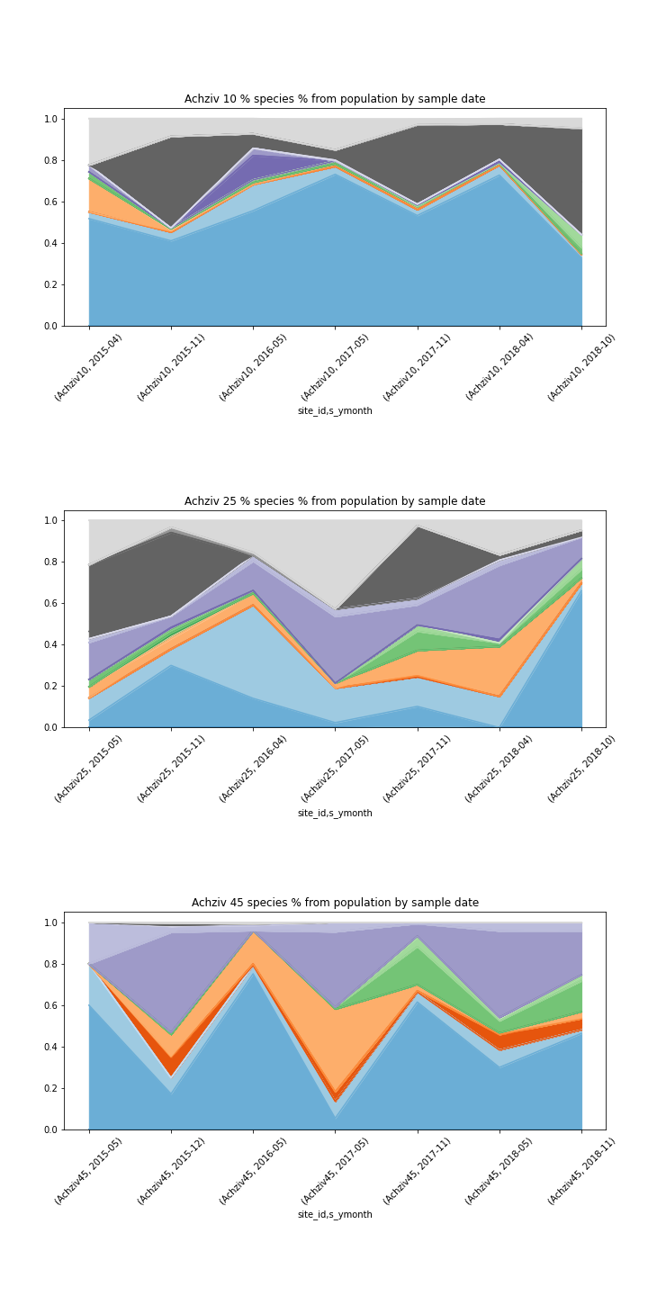
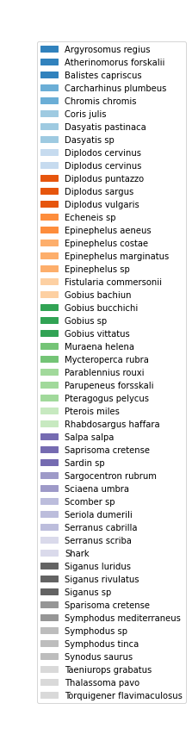
Big changes over time and depth within a site
Achziv Site
10 m
Sampling Time line
25m
Depth
45m

Slide 17
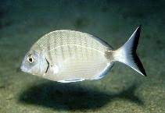
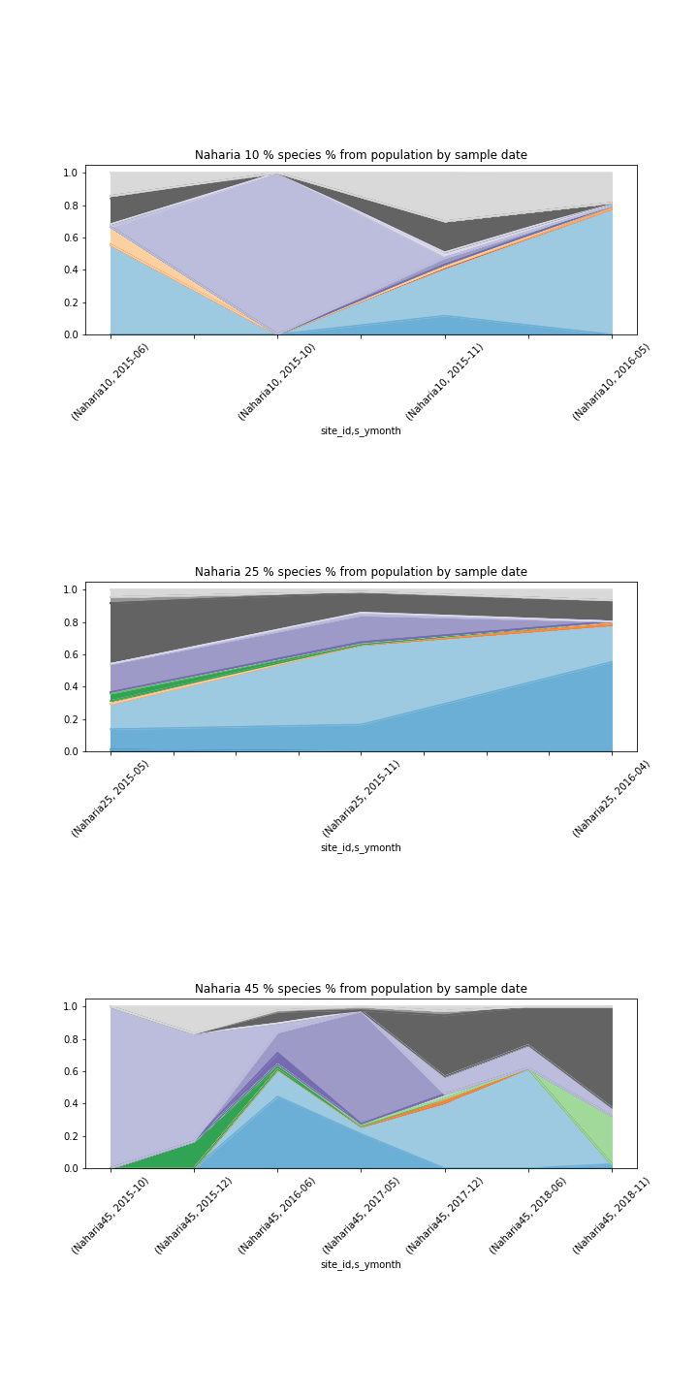
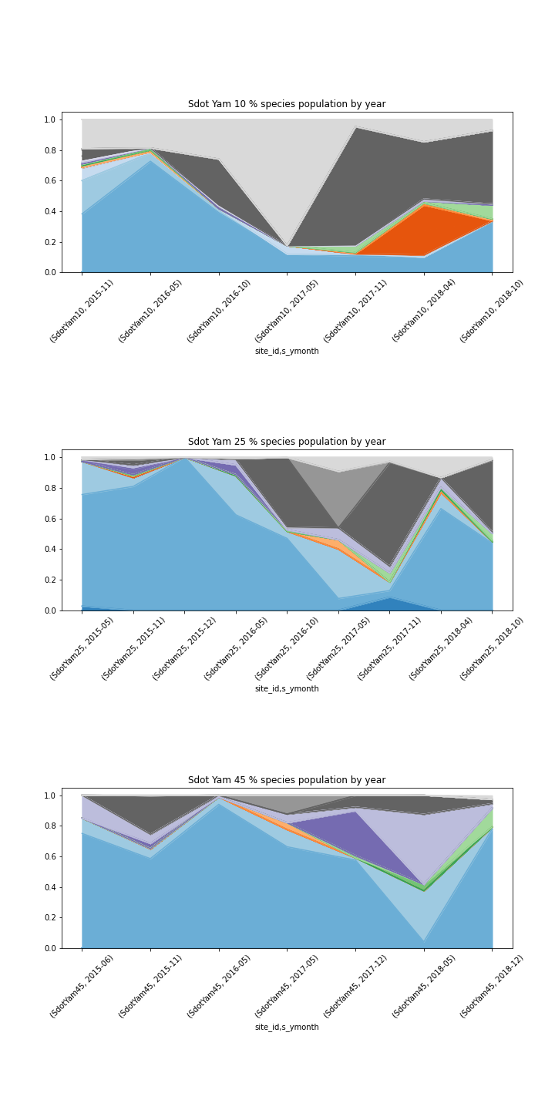
Delta of population trends across timeline and depth within the sites
Achziv
10m
Nahariya
Sdot yam
Sampling Time line
25m
45m
Depth

Slide 18
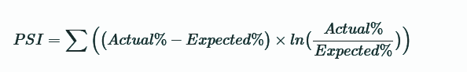
Delta of population trends across timeline and depth of
What is the population stability index (PSI)?
PSI is a measure of how much a population has shifted over time or between two different samples of a population in a single number. It does this by bucketing the two distributions and comparing the percents of items in each of the buckets, resulting in a single number you can use to understand how different the populations are. The common interpretations of the PSI result are:
PSI < 0.1: no significant population change
PSI < 0.2: moderate population change
PSI >= 0.2: significant population change
And in other words..
https://github.com/mwburke/population-stability-index/blob/master/walkthrough-example.ipynb
df['PSI'] = (df['New Percent'] - df['Initial Percent']) * np.log(df['New Percent'] / df['Initial Percent'])

Slide 19

Delta of population trends across timeline and depth of
And the most stable site is..
Achziv 10 | 0.0765
Achziv 25 | 0.1316
Achziv45 | 0.1993
Sdaot Yam 10 | 0.2023
Sdaot Yam 25 | 0.3374
Sdaot Yam 45 | 0.4114
Naharia 45 | 0.3712

